Slide 1



Martian Pit Shadow Extractor (MAPS)
Daniel Le Corre
University of Kent and ACRI-ST
dl387@kent.ac.uk
Supervisors:
Prof. Nigel Mason (Kent), Dr. Jeronimo Bernard-Salas and Dr. Nick Cox (ACRI-ST), Prof. David Mary (OCA)
Europlanet Science Congress (EPSC) 2022
MAPS Splinter Workshop
Tuesday 20th September

Slide 2
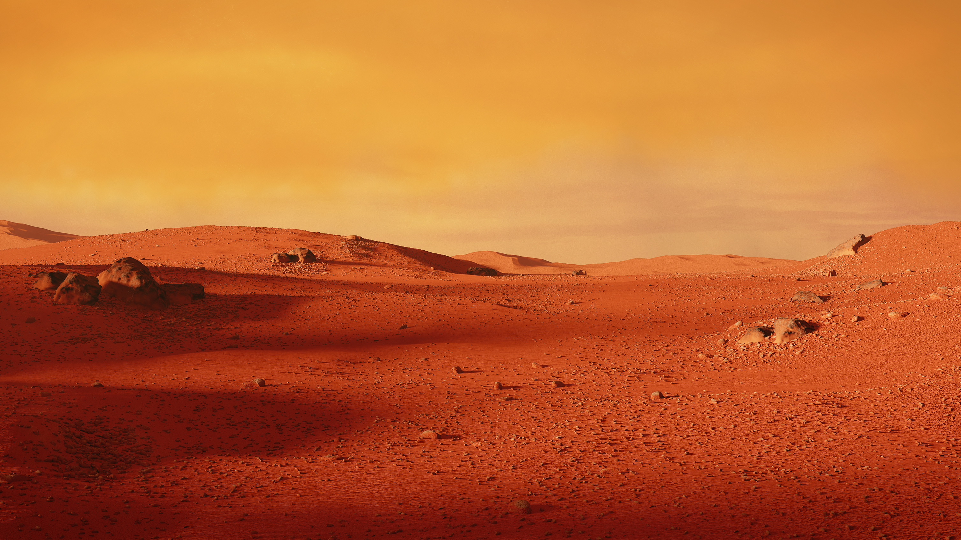
Topics
Introduction to MAPS
Why pits, and why measure their depths?
Turning a shadow into a depth
Testing results and a case-study

Slide 3
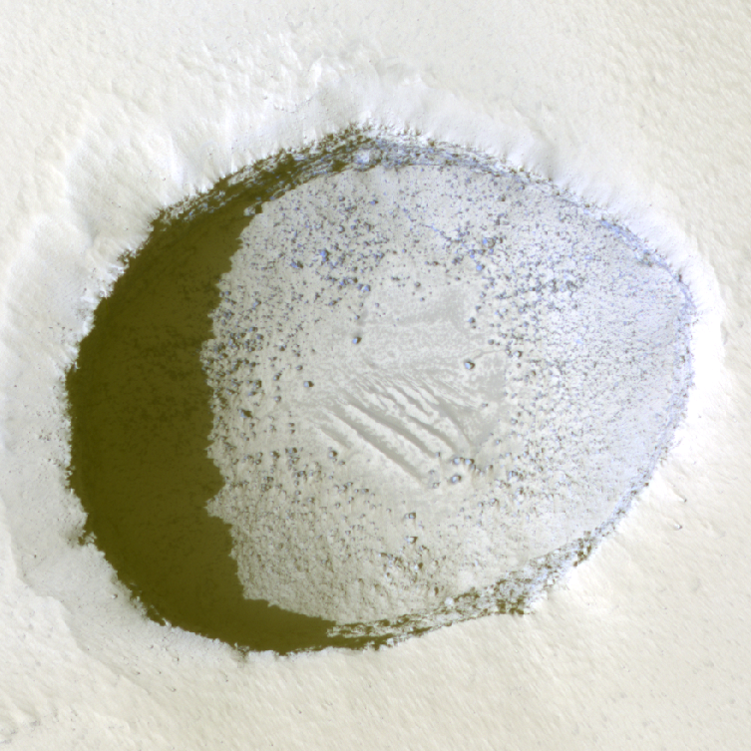
Introduction to MAPS
MAPS (Martian Pit Shadow Extractor) is a python tool for automatically extracting the shadow from cropped, multi- or single-band, remote-sensing images of Martian pits - as a means of calculating their apparent depths.

Slide 4
Why Pits?
What is so special about pits and why is it important to know their depths?

Slide 5
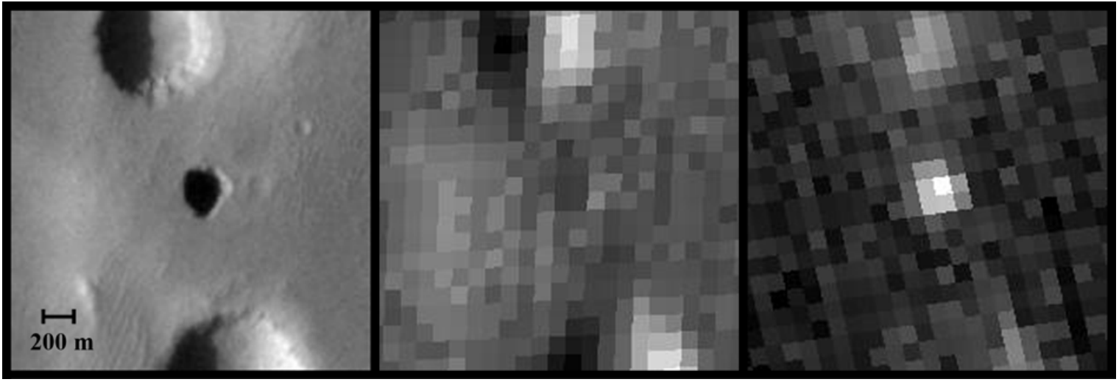
What’s so interesting about pits?
Cushing et al. (2007)
Some pits on Mars are potential entrances to underground caves.
Thermal imagery reveals that the properties of the interiors of some pits were analogous to sub-surface material.
Mars Odyssey
THEMIS visual image
Daytime IR Image
Night-time IR Image

Slide 6
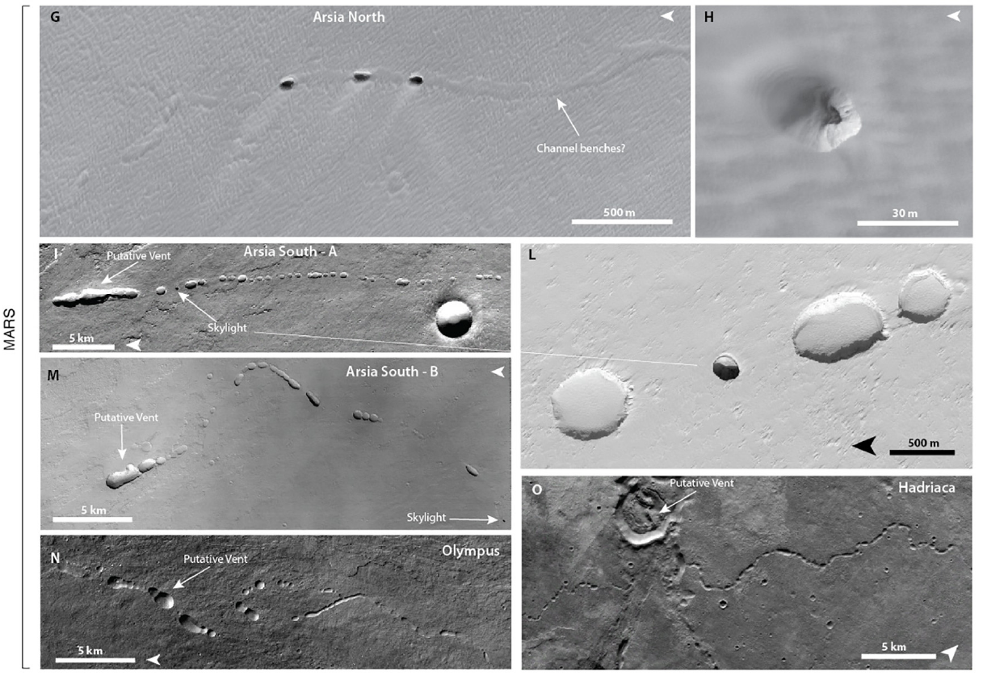
What’s so interesting about pits?
Sauro et al. (2020)
The alignment of pits into chains may also signify the presence of intact lava tubes.
Lava tubes on Mars are expected to be larger in volume than on Earth.
…and even larger on the Moon!

Slide 7
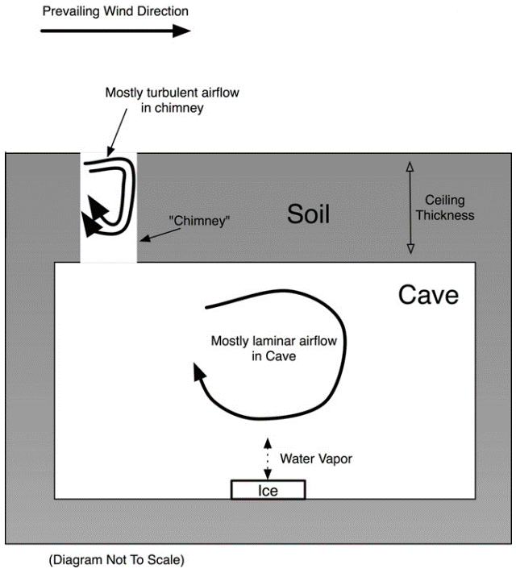
Why Martian Pits?
Williams et al. (2010)
Ice caves have been shown to be stable across much of Mars.
High ceiling thicknesses can cause “cold trapping”.
Astronauts would experience high doses of ionising radiation on Mars.
Caves have been identified as “the best option” for a Martian habitat in terms of radiation exposure (Atri et al. 2022).

Slide 8
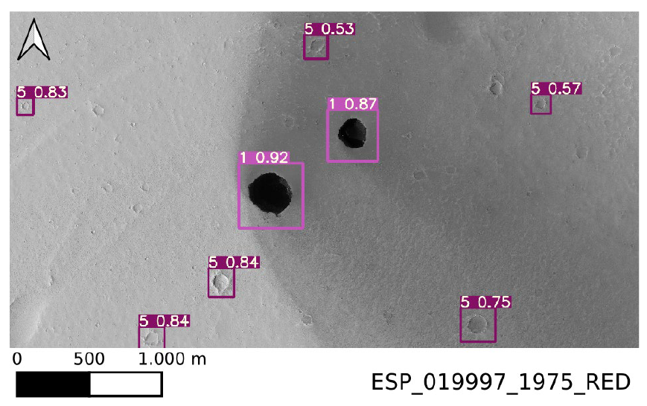
Why automate this process?
Nodjoumi et al. (2021)
Current Martian cave catalogue (Mars Global Cave Catalog, MGC³) has > 1,000 features.
Moon catalogues are also being developed.
Deep Learning is being used to detect more pits

Slide 9
Automatically Extracting Shadows
Finding an accurate and robust (but still simple) method of automatically extracting a pit’s shadow

Slide 10
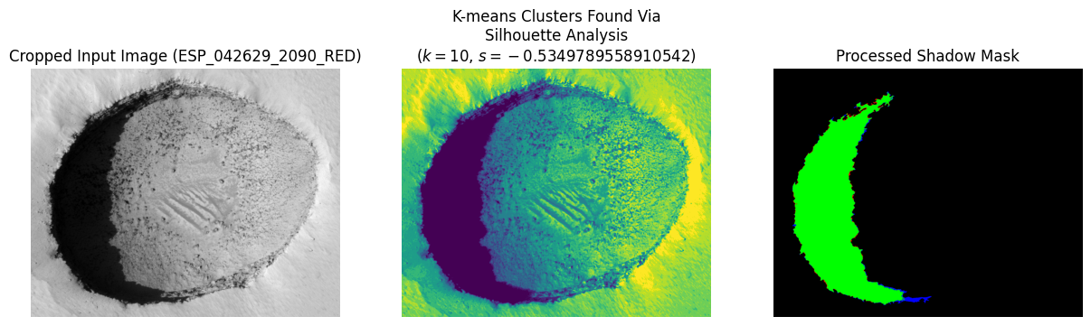
Using K-means Clustering and Silhouette Analysis
K-means groups n data points into k ‘clusters’ by minimising the squared Euclidean distances between all data points in the same clusters.
However, k must be known before K-means is applied.
Silhouette Analysis is used to find the value for k which gives the most distinct clusters.
MAPS selects the darkest cluster as the shadow.

Slide 11
Turning A Shadow into a Depth
Now we have found the pit’s shadow, how do we turn that into a depth?

Slide 12
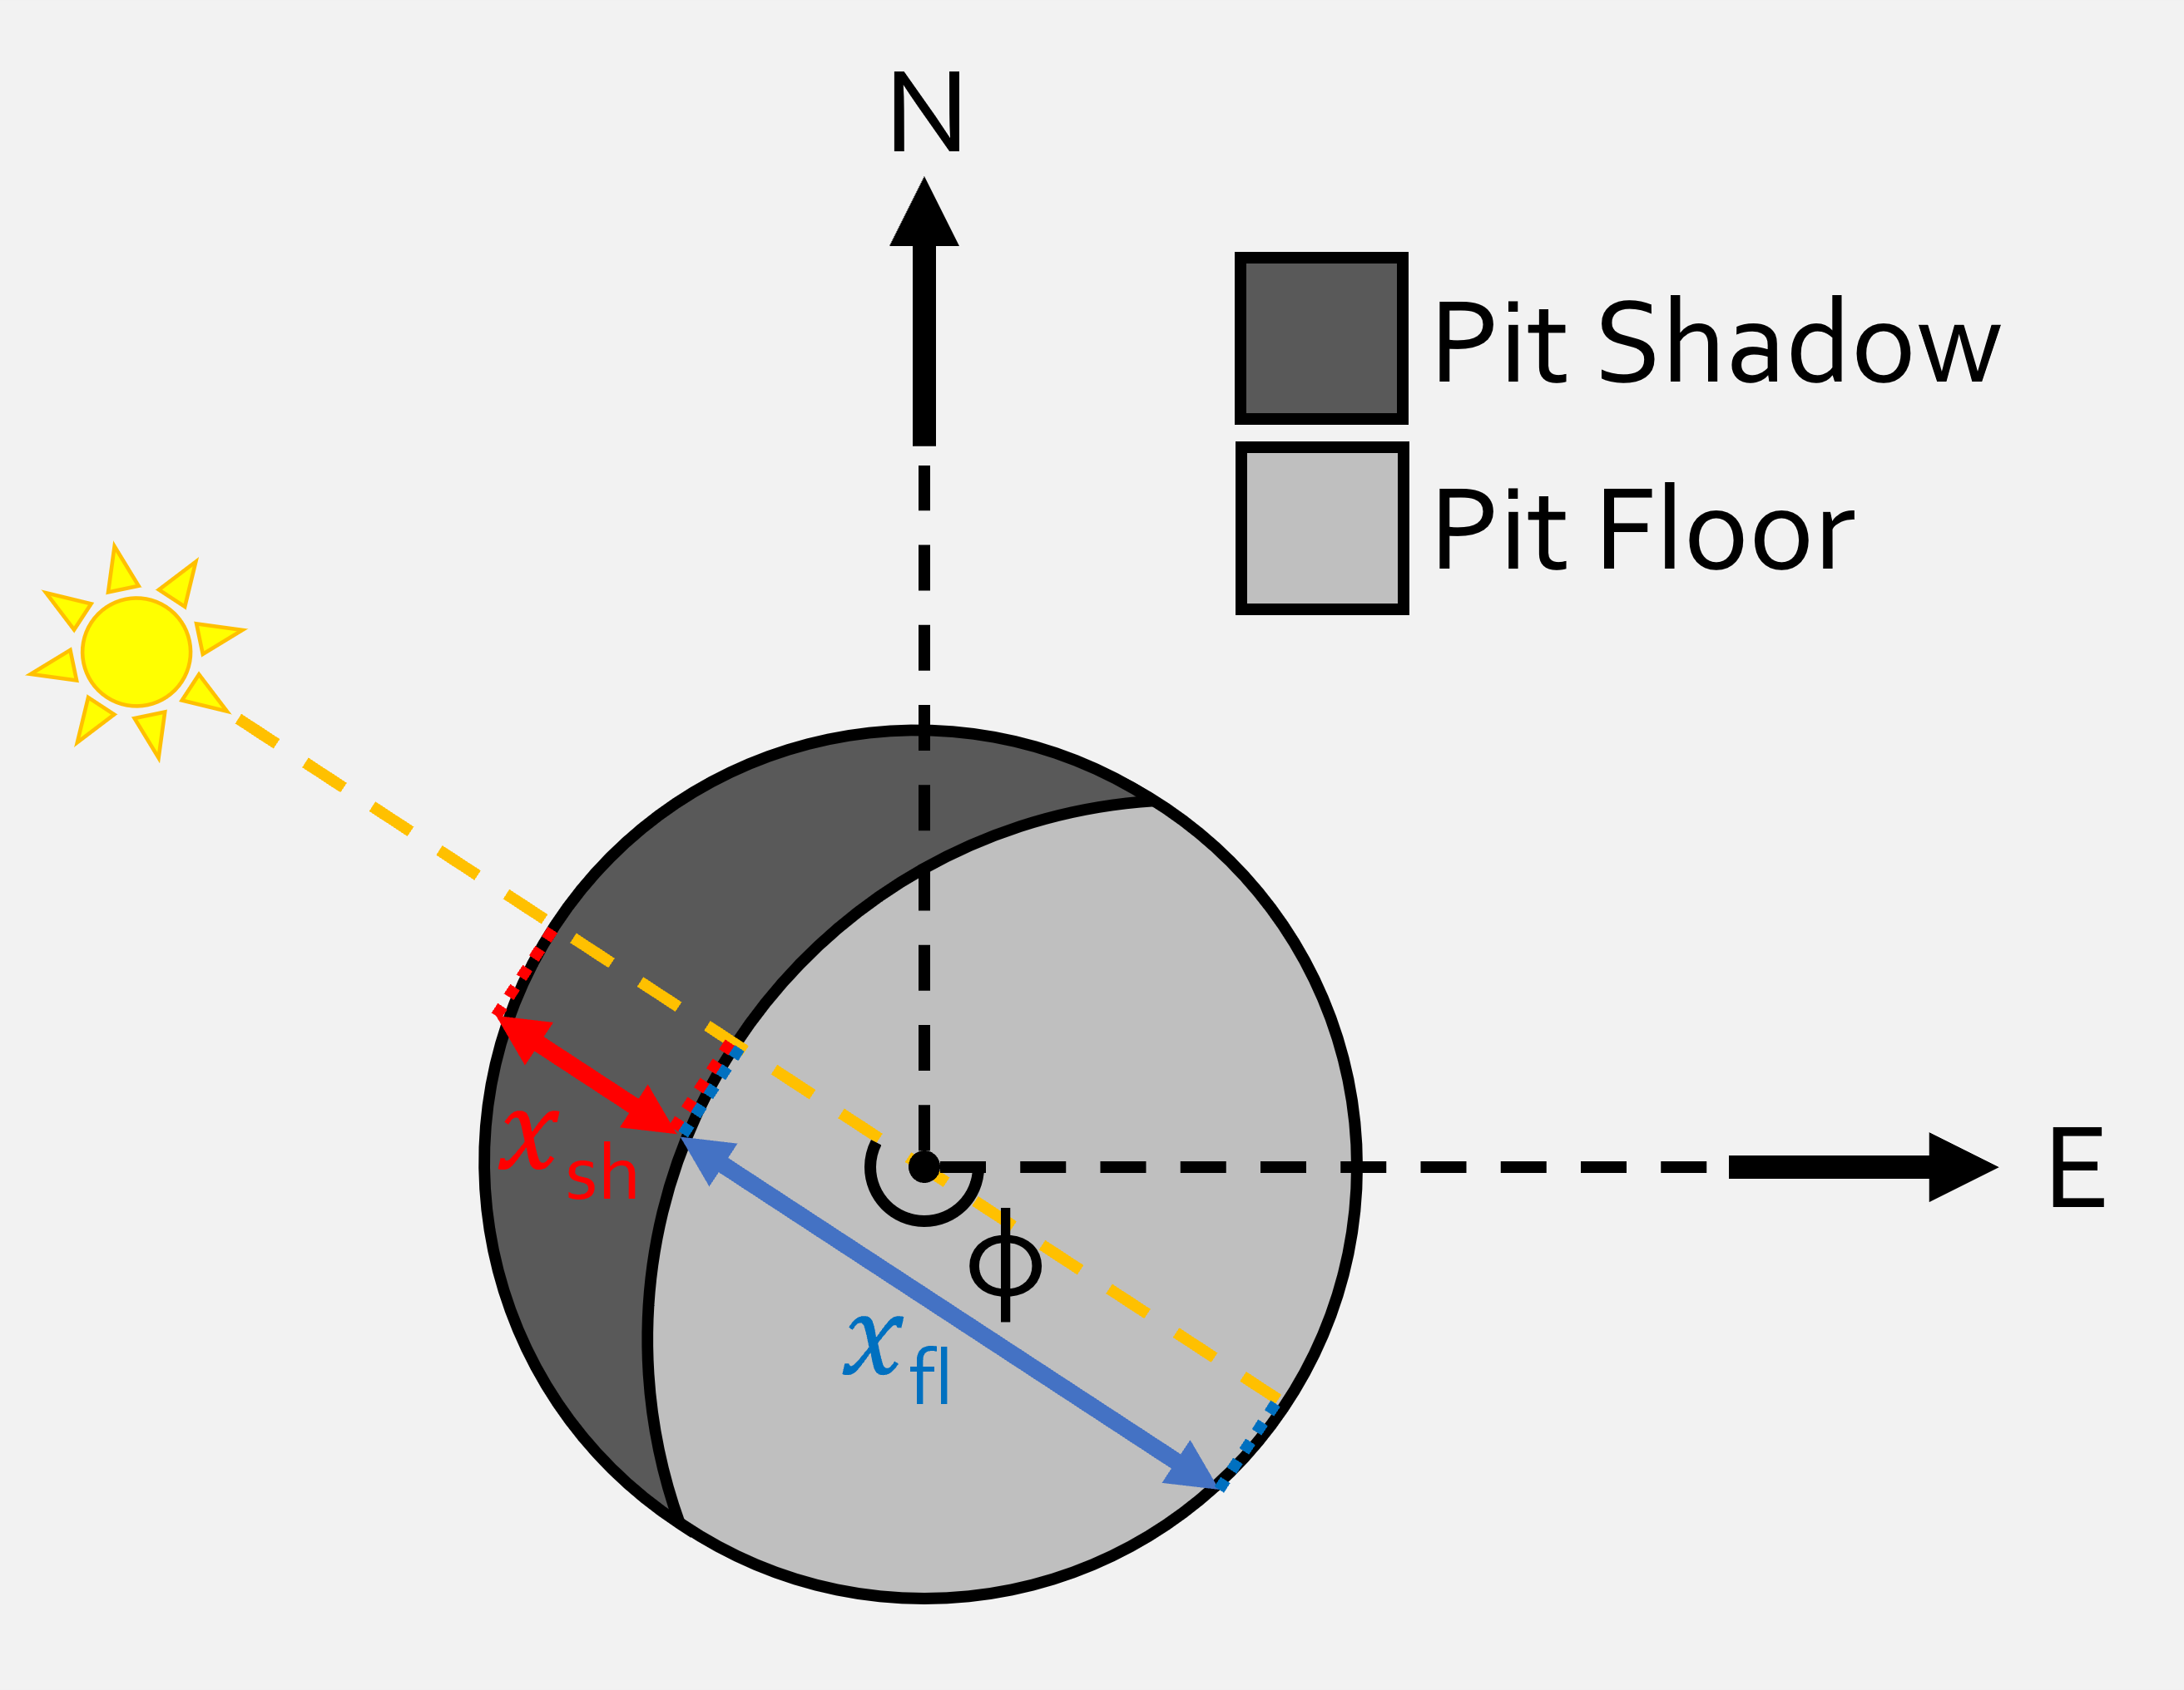
Calculating the Apparent Depth of Martian Pits
Top-down Schematic
MAPS automates the approach from Wyrick et al. (2004).
However, MAPS rotates the shadow mask by the Solar Azimuth Angle (φ) to measure the shadow width (x_{sh}).

Slide 13
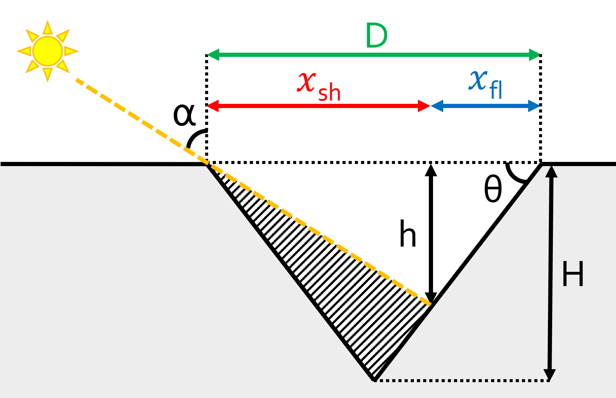
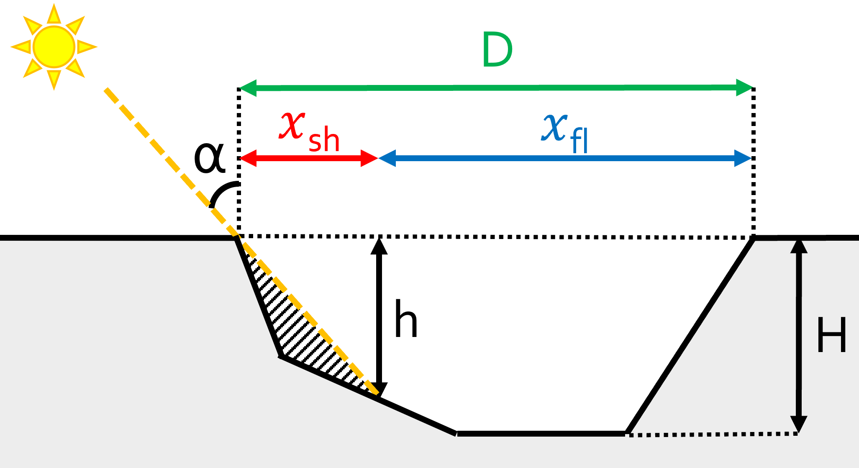
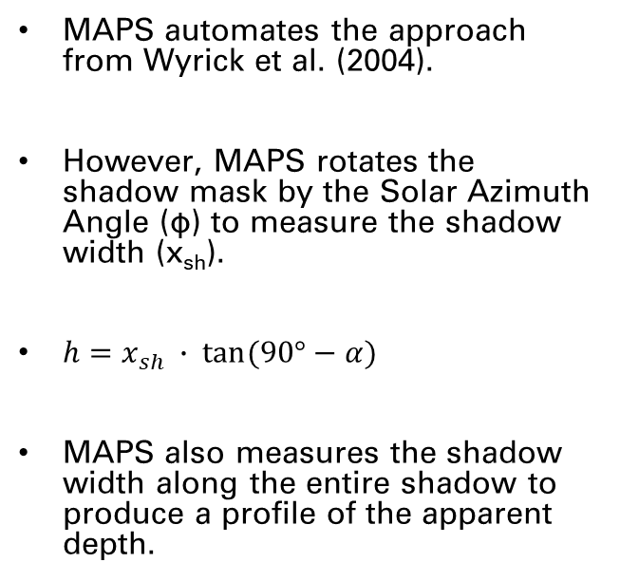
Calculating the Apparent Depth of Martian Pits
Cross-sectional Schematics
Figure adapted from
Wyrick et al. (2004)
MAPS automates the approach from Wyrick et al. (2004).
However, MAPS rotates the shadow mask by the Solar Azimuth Angle (φ) to measure the shadow width (x_{sh}).
$h=x_{sh} ∙ tan⁡(90°−α)$
MAPS also measures the shadow width along the entire shadow to produce a profile of the apparent depth.
MAPS does not assume pits are conical

Slide 14
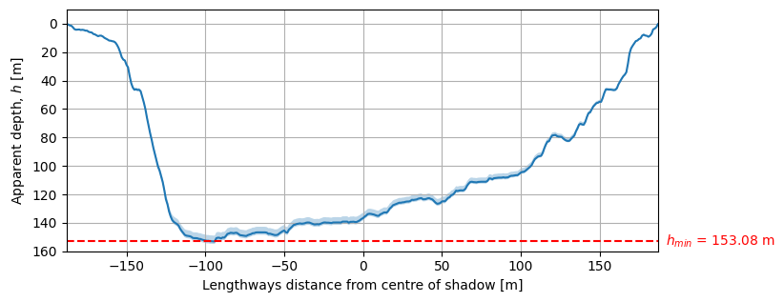
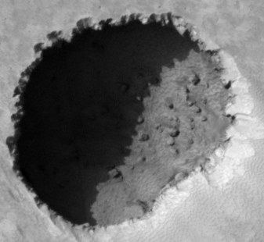
Apparent Depth Profile
HiRISE image: ESP_033342_1660_RED

Slide 15
Summary of MAPS Algorithm
Reading Images
MAPS starts by reading in the input remote-sensing images and sensing information.
Shadow Extraction
MAPS applies K-means clustering and Silhouette analysis to find the number of clusters that produces the most distinct clusters.
Post-processing
All small shadow detections are removed from the final shadow mask.
All holes in the mask are also filled.
Depth Calculation
MAPS uses the Sun’s position to automatically measure the shadow width and find the apparent depth.
Saving Outputs
CSV file of the calculated apparent depths, a profile of the apparent depth, a shapefile of the extracted shadow

Slide 16
Testing MAPS on HiRISE Images
How does MAPS perform? How much does it vary?

Slide 17
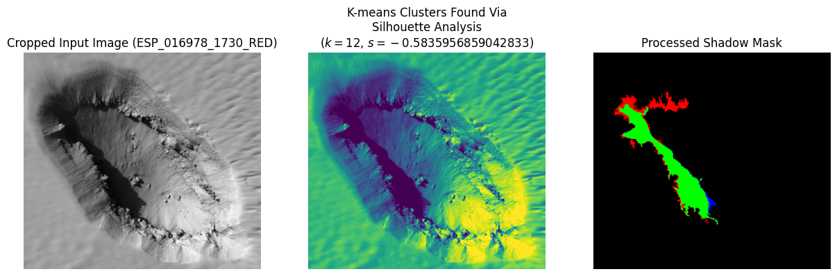
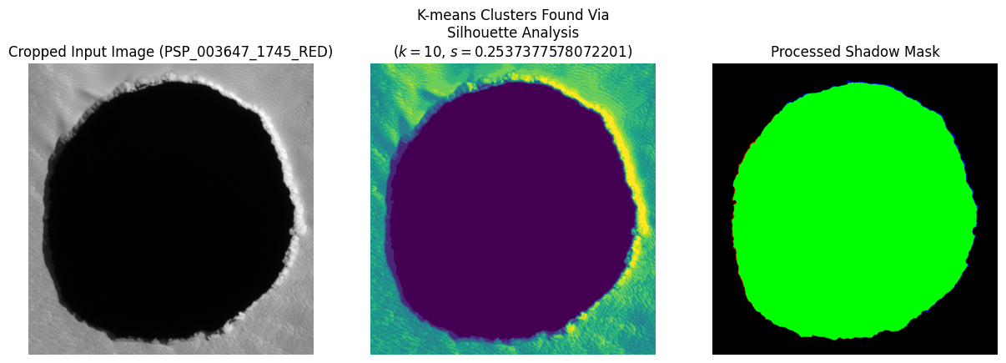
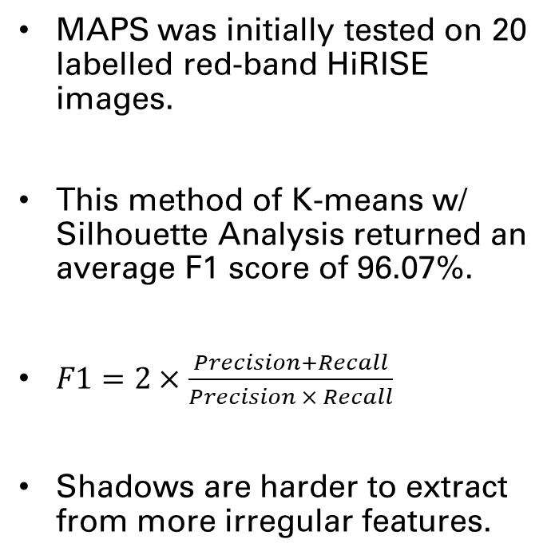
Testing MAPS’s Shadow Extraction on HiRISE Images
Lowest F1: 82.47%
MAPS was initially tested on 20 labelled red-band HiRISE images.
This method of K-means w/ Silhouette Analysis returned an average F1 score of 96.07%.
$F1=2×\frac{Precision+Recall}{Precision × Recall}$
Shadows are harder to extract from more irregular features.
Highest F1: 99.57%

Slide 18
Applying MAPS to a pit Catalogue
Preliminary Results of Applying MAPS to a catalogue of Martian pits - the Mars Global Cave Candidate Catalog (MGC³)

Slide 19
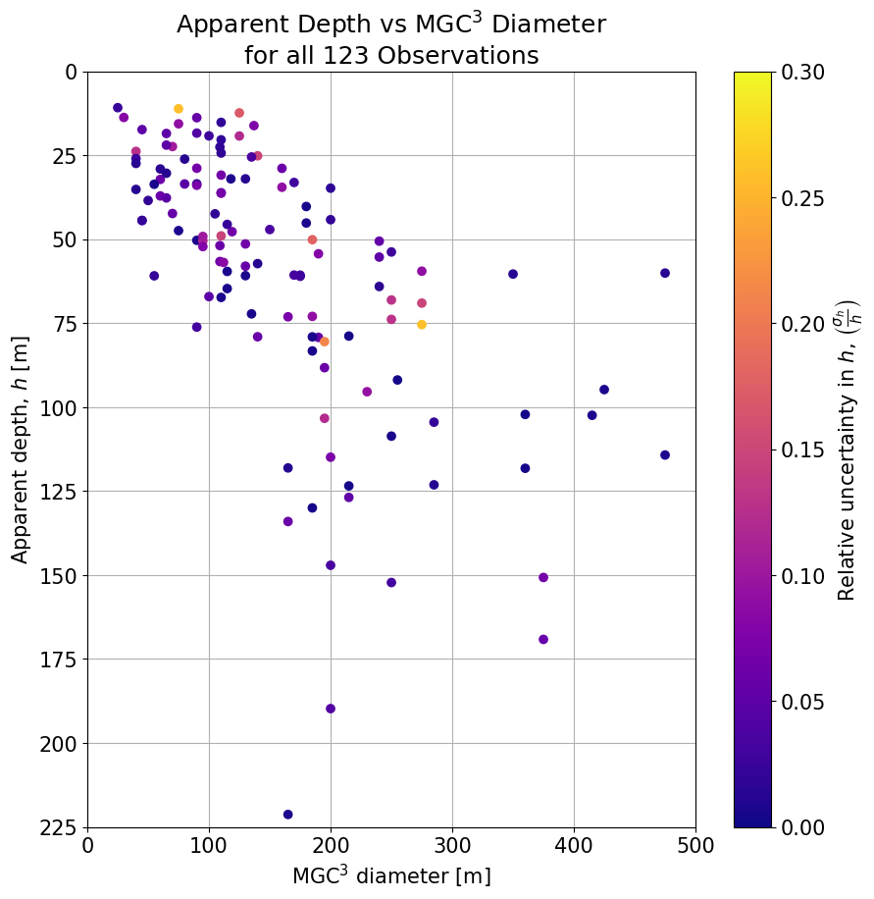
Depth Against Diameter
A positive correlation between apparent depth and diameter.
No trend between relative uncertainty and size of a pit.
MAPS can be applied to pits on all scales.

Slide 20
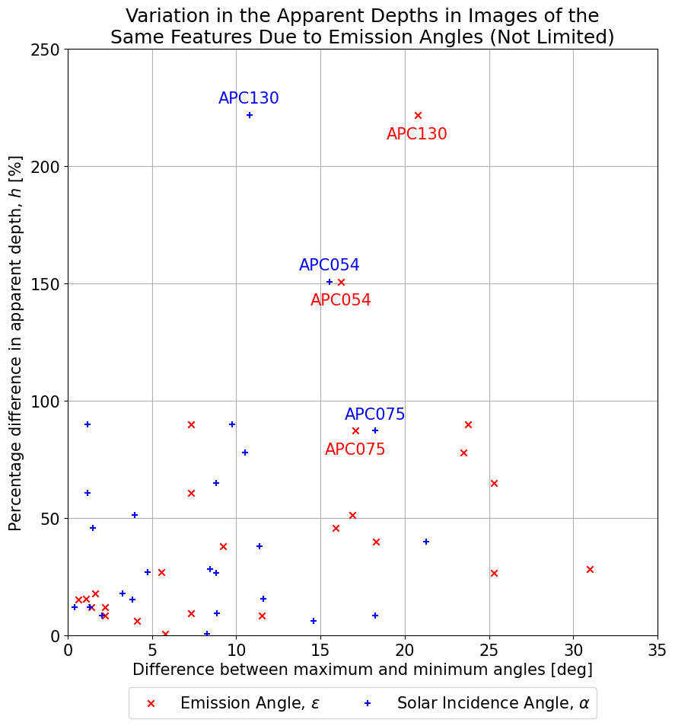
Emission Angle Affects Apparent Depth Calculation
Many of the features in MGC³ have been observed more than once by HiRISE.
Two images with large differences in emission angle will show significantly different apparent depths.

Slide 21
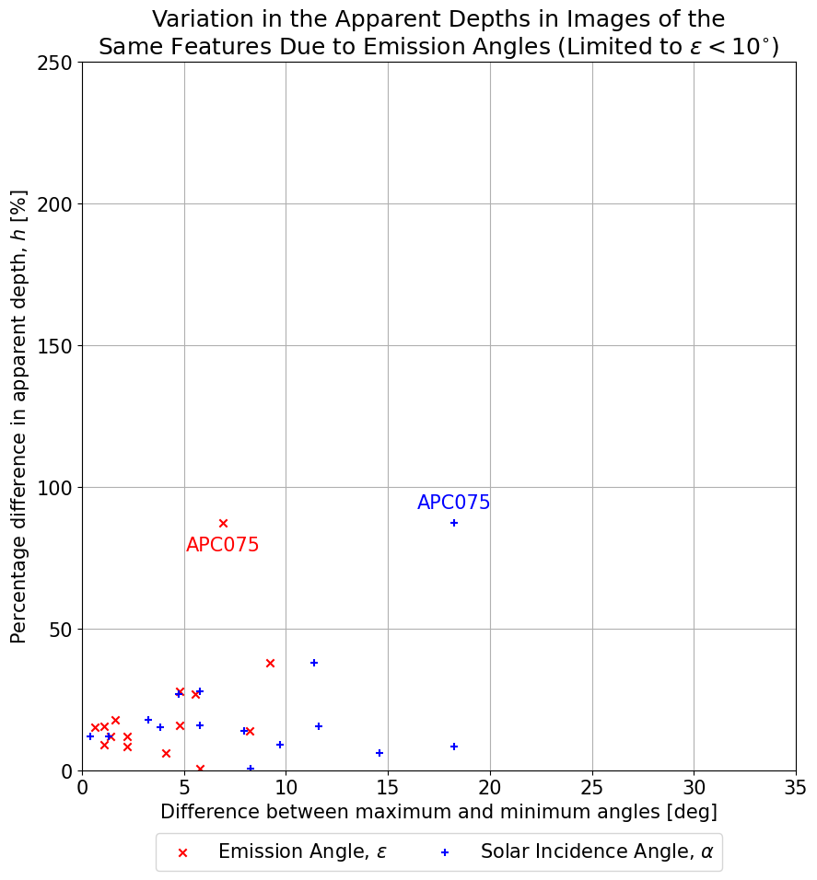
Emission Angle Affects Apparent Depth Calculation
Many of the features in MGC³ have been observed more than once by HiRISE.
Two images with large differences in emission angle will show significantly different apparent depths.
MAPS shouldn’t be applied to images with ε > 10⁰.

Slide 22
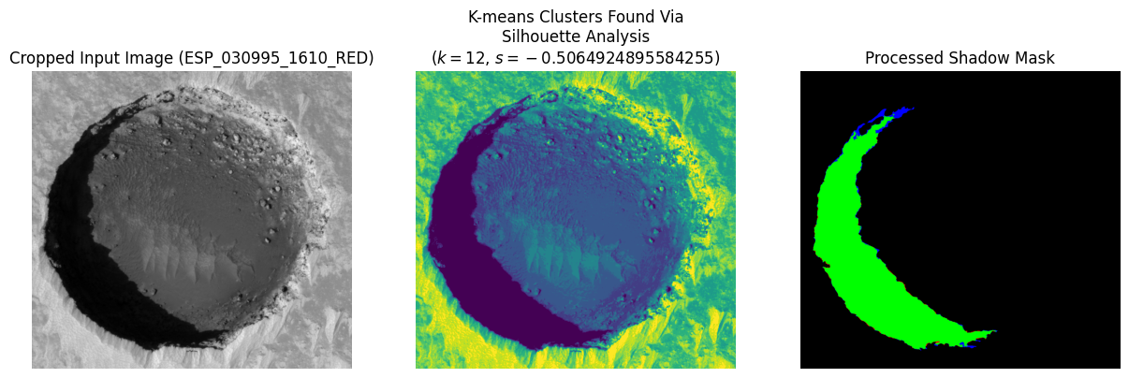
Summary
MAPS can accurately (and quickly!) extract the shadow from remote-sensing images of Martian pits, as a way of calculating their apparent depths.
Although, the method is applicable to most rocky bodies.
No restriction on the scale of pit.
MAPS is less accurate on highly irregular features or when ε is high.

Slide 23

Thank you for your attention!
Any questions?
Contact Email: dl387@kent.ac.uk
Website: danlecorre.com
This project is part of the
Europlanet 2024 RI which has received funding from the European Union's Horizon 2020 research and innovation programme under grant agreement No 871149

